Slide 1

Buildable Digital Health Blueprint
Workshop-3
Digital Health Building Blocks

Slide 2

Workshop plan…
Leverage each successive workshop to progress the development of the blueprint:
Use cases (choosing our initial care pathways)
Digital health specifications (Integration Profiles)
“Building blocks” (conformant solutions)
Implementation science (making it “go”)
Each session builds on the one before it…

Slide 3

Workshop-3
Building Blocks

Slide 4
Workshop-3 Agenda
Brief recap and review
Landscape: what digital health solutions are broadly deployed, now?
Opportunities:
Which solutions could potentially be leveraged to accelerate the construction of the national HIE infrastructure?
Which POS solutions will help us generate implementation momentum when we connect them to the HIE (e.g. via a façade, etc.)?
Next steps

Slide 5

Which digital health solutions have already been taken to national scale?

Slide 6
What is the current landscape?
<lookup country entries on the Global Digital Health Atlas; prepare a set of slides summarizing the findings: https://digitalhealthatlas.org/en/-/>
<leverage a desk review and pre-workshop interviews with MOH to augment the findings from the Atlas. Prepare a set of slides to depict the findings.>
<cross reference findings from steps 1 & 2 to the Digital Square Global Goods for Health (https://digitalsquare.org/digital-health-global-goods) listing and the Digital Public Goods Alliance (https://digitalpublicgoods.net/registry/) listing. Prepare slides that summarize the findings.>

Slide 7

Interaction 3.1
Share Form 3.1 with attendees or with MOH teammates ahead of WS-3
Prepare a set of slides that report the results collected using Form 3.1 and share these with the WS-3 attendees. NOTE: flag errors, if you find them – especially cases where existing POS solutions are flagged as candidates for HIE-level deployment.

Slide 8
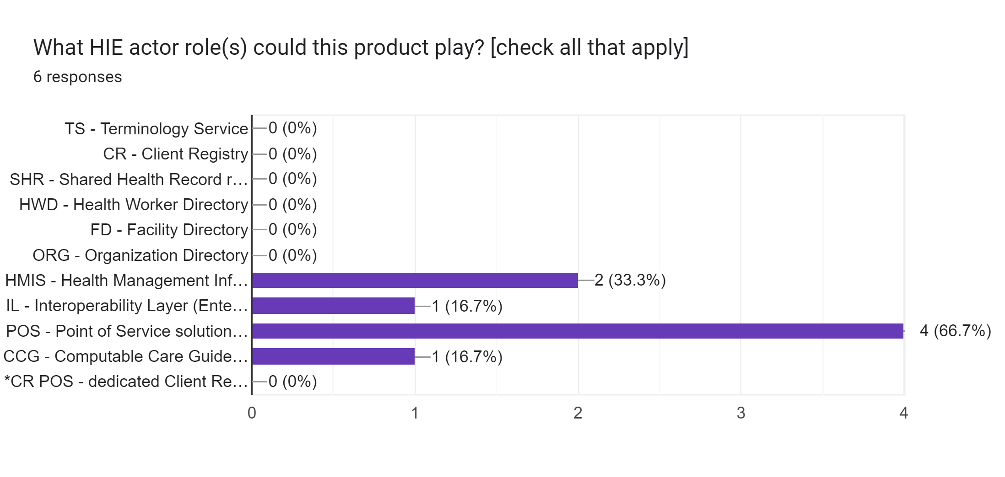
HIE Infrastructure (“in the cloud”)
POS solutions
(“on the ground”)

Slide 9
Name:
Overview:
Actor role:
Present Scale:
Interop. Standards:
Source code:
Est. annual support (USD):
Organization:
National HMIS (DHIS2)
National HMIS
HMIS
All facilities regularly report indicators to this database.
HL7 FHIR, Proprietary API
Open source
100k
DHIS2 (Oslo)

Slide 10
Name:
Overview:
Actor role:
Present Scale:
Interop. Standards:
Source code:
Est. annual support (USD):
Organization:
Country HIE System (CHIES)
The Country Health Information moving disparate systems across to a consolidating electronic system. Health data is currently managed on various platforms in the country; paper forms, the EMR, the HMIS, the electronic Laboratory Information System (LIS) and other databases. The non-integration between these platforms at the facility or national levels affects data integrity and quality negatively. There was therefore a need to develop an integrated health information system that synchronizes data entry and reporting across various health databases to reduce transcription errors, data capture errors, and reduce reporting time. The “Country Health Information Exchange system” is a set of applications that work together in the Open Health Information Exchange (OpenHIE) architecture to serve point-of-service systems, like EMRs, DHIS2, National ID database and laboratory information system. The main feature of this project was the deployment and configuration of an interoperability layer designed to ease data exchange.
IL – Interoperability Layer
National scope but not all solutions or facilities are connected.
HL7 FHIR, HL7 CDA, HL7v2, Proprietary API
Open source
100k
VICS co. & MOH

Slide 11
Name:
Overview:
Actor role:
Present Scale:
Interop. Standards:
Source code:
Est. annual support (USD):
Organization:
E-Heza
E-Heza is the country's first point-of-care data solution that was created alongside front-line health care workers and the Ministry of Health. E-Heza will dramatically improve maternal and child health outcomes by giving nurses the tools they need to adopt evidence-based clinical care protocols, provide high quality care and utilize real-time data trends to tailor health education to individual family needs while simultaneously satisfying Ministry of Health data reporting requirements. In response to Covid-19, E-Heza is developing an Acute Illness Assessment & Management module for CHWs and nurses at health centers. This module allows CHWs to enter responses to guided screening questions. If Covid-19 is suspected, an alert immediately advises the CHW to isolate the community member and contact the health center. Care management can continue in the same patient record at the health center. If Covid-19 is not suspected, the CHW can continue with assessment and management of the relevant condition. A facility-level Covid-19 module has recently been developed and deployed that allows frontline health workers to provide symptom review and physical exam, rapid testing if indicated, and decision matrix for high and low risk confirmed cases. A contact collection tool in incorporated into the visit so health workers can document contacts. The documented contacts populate a Contacts Management module that allows health workers to follow up on all contacts.S
POS
4 districts, 180 facilities, 400+ CHWs, 70k patients
HL7 FHIR
Open source
100k
Example Organization Inc.

Slide 12
Name:
Overview:
Actor role:
Present Scale:
Interop. Standards:
Source code:
Est. annual support (USD):
Organization:
Country Health Analytics Platform (CHAP)
CHAP is a rapid data integration and advanced analytics platform developed with the Country Biomedical Center (CBC). CHAP enables data triangulation, processing, and visualization of fragmented data. The platform resolves critical differences in datasets by harmonizing location naming, data collection cadence, indicators, names, etc). CHAP is a web application that can be accessed with web connection. The CHAP integrates data from the facility level health information system, the community health information system, the DHS, the Integrated Supervision Survey and data from an electronic LMIS to support and improve data-driven decision making. Currently the project is looking at expanding the scope by integrating additional datasets such as HIV, TB, etc.
POS, HMIS
66 sites
Proprietary file format import / export
Closed source
100k
CHAP Company

Slide 13
Name:
Overview:
Actor role:
Present Scale:
Interop. Standards:
Source code:
Est. annual support (USD):
Organization:
ANC CCG Module
Following the adaptation of the national ANC policy and guideline, the country is now embarking on efforts to test innovative ANC service delivery approaches and mechanisms to improve the quality of antenatal care in line with the 2016 WHO recommendations. The country will be adopting a person-centered digital tracking and decision support system to potentially accelerate the adoption of the new ANC recommendations and policies. This digital health system is a software global good, the WHO digital ANC module, which has been created on the OpenSRP platform. Ministry of health will adapt and update the WHO digital ANC module to better reflect the new national ANC policies and country contexts. Implementation of these modules will take place in selected districts (A & B Districts) that will allow larger scale-up if the initiative is successful.
POS, CCG
Pilot in 2 regions
HL7 FHIR
Open source
100k
Open open co.

Slide 14
Name:
Overview:
Actor role:
Present Scale:
Interop. Standards:
Source code:
Est. annual support (USD):
Organization:
Umurinzi Ebola Vaccination App
A two-dose preventive Ebola vaccination campaign was set up targeting approximately 203,000 residents considered at risk of acquiring Ebola Virus Disease due to frequent transit for work reasons across the border. A first generation Vaccination Monitoring Platform was used to support correct vaccine administration, follow-up/recall of vaccinated persons and provide data-driven dashboard reports in close to real time that aided understanding of campaign effectiveness. Between December 2019 and September 2021, 219,775 individuals attended vaccination sites and 216,114 received the first vaccine dose. Of these 216,114 persons having receive first dose of vaccine, 94.3% came back for the second dose and 203,309 of them received it. The overall cumulative dose 2 retention was ~94%.
POS
+200k patients
Proprietary API, CSV import/export, proprietary file format import/export
Open source
250k
Coalition

Slide 15
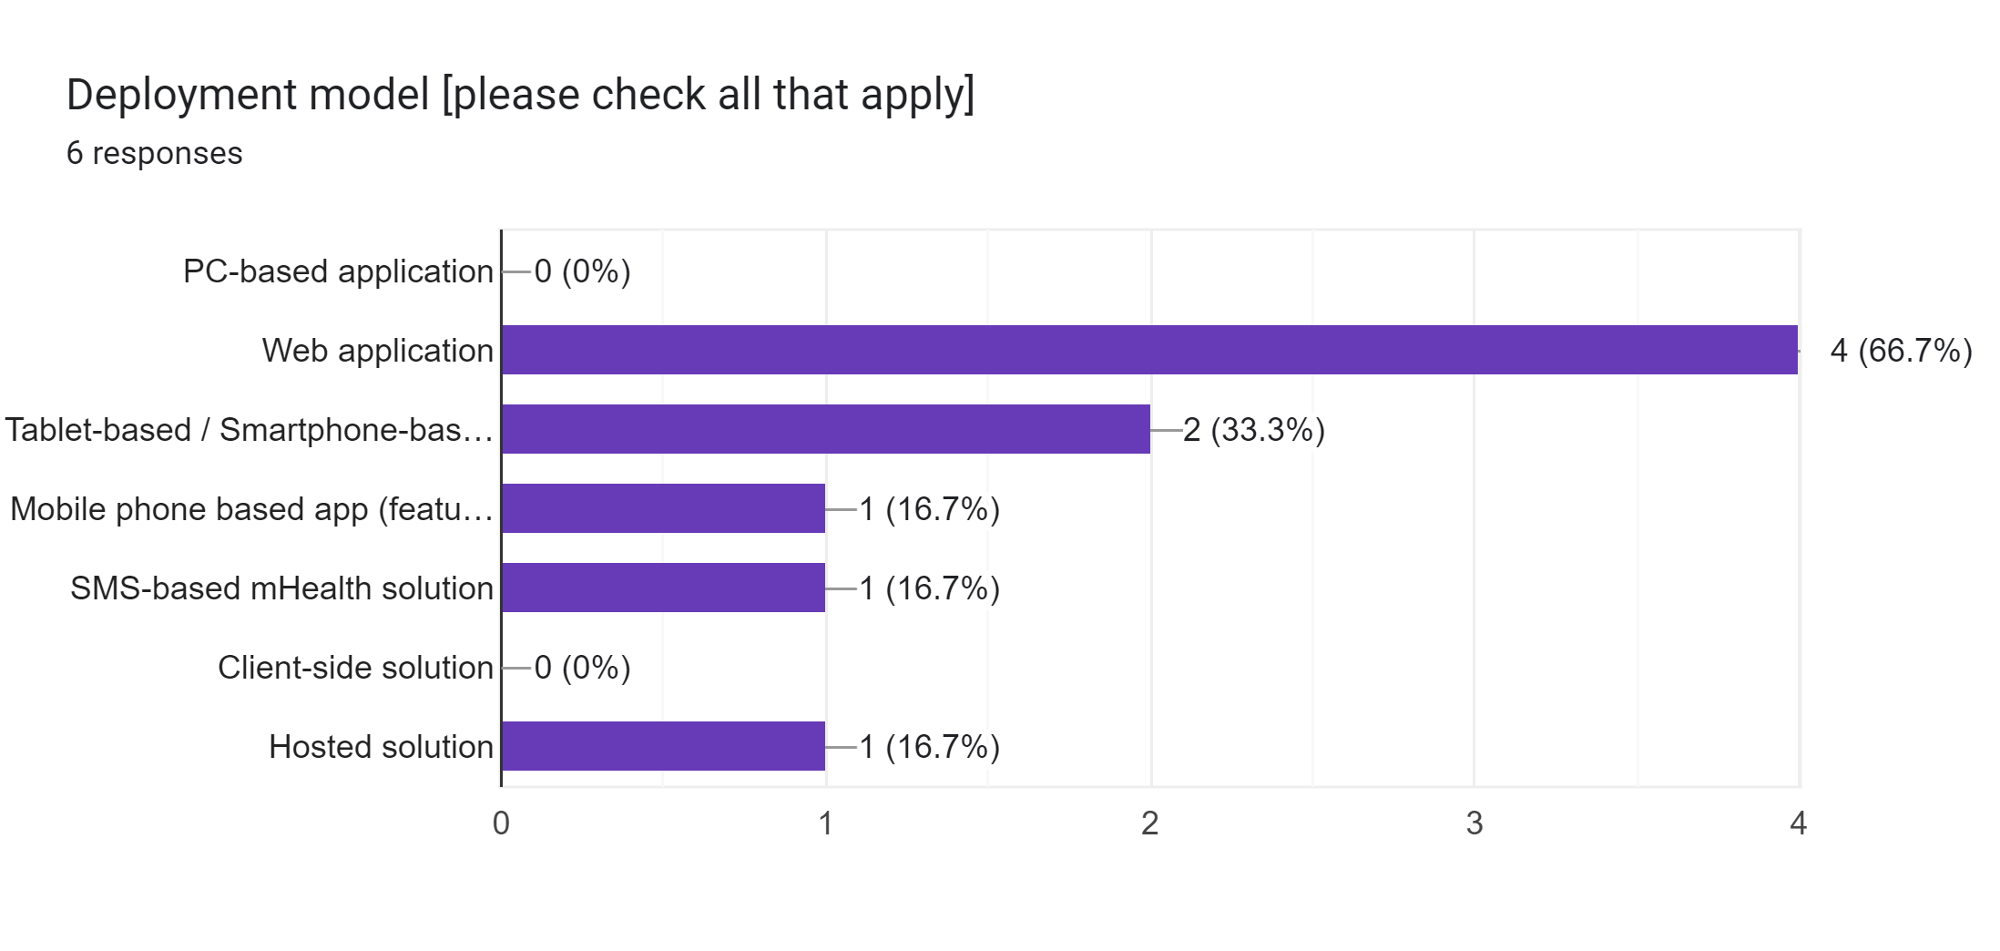

Slide 16
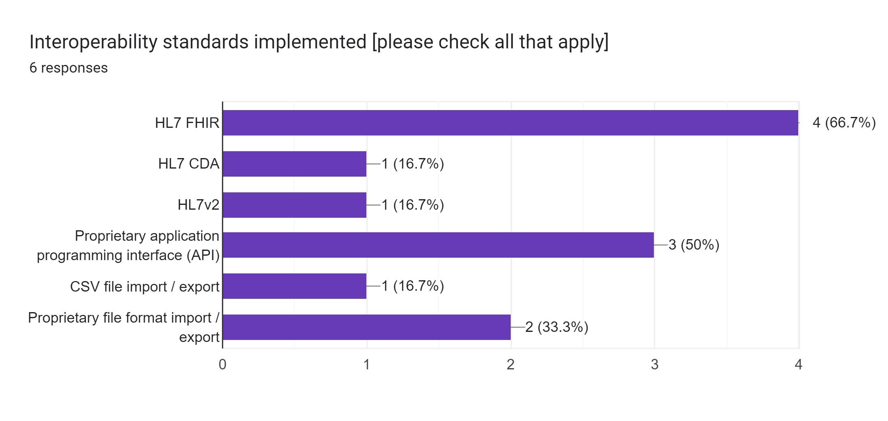

Slide 17
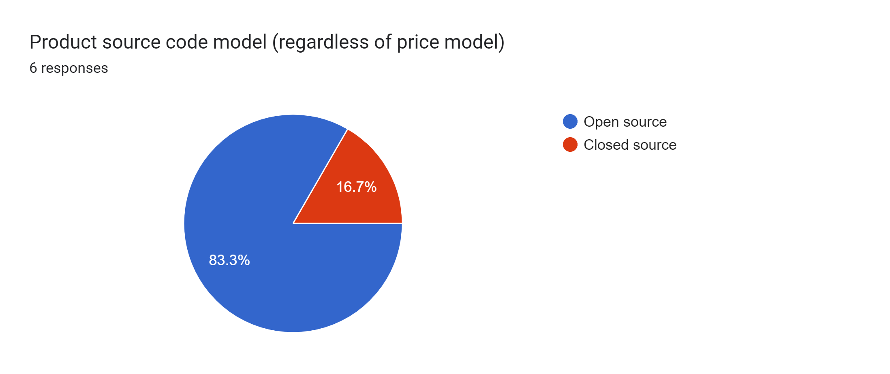

Slide 18

Key takeaway points:
The only HIE “infrastructure” elements for which we have options are the HMIS and the Interoperability Layer.
Most of the existing digital health solutions are point of service (POS) solutions.
One CCG is available: the WHO’s ANC SMART Guideline.
Four of the six solutions support FHIR.
Five of the six solutions are open source.

Slide 19


Slide 20
Do any of our existing solutions afford us opportunities to accelerate our HIE implementation?

Slide 21
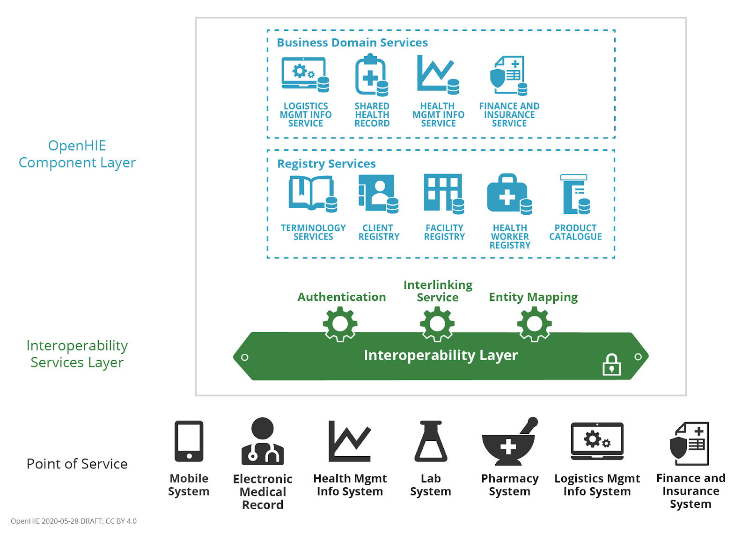

Reminder
Leveraging the terms used to describe the OpenHIE architecture, which existing solutions could play which actor roles in our national HIE?

Slide 22



Client Registry (CR)
The CR is the definitive all-persons registry of demographic data about each individual, including their unique ID for health.
Interlinked Facility Registry (ILR-FR)
The ILR-FR is a definitive registry of all health facilities, both private and public sector. It includes information about the location, services and operating times – and is the source of the facility’s unique ID.
Interlinked Health Worker Registry (ILR-HWR)
The ILR-HWR is a definitive registry of all health workers, both private and public sector. It includes demographic information about the health worker including their cadre and where they provide services. It is the normative source of the worker’s unique ID.

Slide 23



Terminology Service
The TS is a normative repository of the national digital health codes and the relationships between them.
Organizations Registry (ILR-ORG)
The ILR-FR is a definitive repository of health system organizations and the relationships between them.
Health Management Information System (HMIS)
A Health Management Information System is a database system explicitly designed and optimized for conducting and generating analyses of health system data.
Share Health Record Repository (SHR)
The SHR is the HIE’s repository of person-centric information that establishes each individual's longitudinal electronic health record.

Slide 24


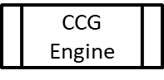
Interoperability Layer (IL)
The Interoperability Layer is sometimes called an enterprise services bus (ESB). It is a digital health architectural element that coordinates and audits transactions submitted by authenticated systems.
Point-of-Service solution (POS)
The POS solutions are the ones that are used by humans to support care encounters. These include electronic medical records (EMR) solutions, lab systems, pharmacy systems, diagnostic imaging solutions, dentistry solutions, patient-facing apps, etc.
Computable Care Guidelines Engine (CCG)
POS solutions that perform clinical decision support may do so through using a CCG engine to process care guidelines that have been published in a standards-based, computable, format.

Slide 25

Important notes…
Existing POS solutions can almost never be used as “HIE elements”. The design of a system targeted for human use is typically very different from that of a web service.
Existing data, however, can give us a good running start if we import it into a high-performance web service.

Slide 27
Interaction 3.2
<insert Form link, here>
Can we leverage existing digital health solutions as:
Terminology Service / Health Services Directory
Client Registry
Health Worker Directory / Registry
Facility Directory / Registry
Organization Directory / Registry
Shared Health Record Repository
Health Management Information System
Interoperability Layer (security, auditing, etc.)
POINT of SERVICE (POS) Solutions (EMRs, mHealth apps, etc.)

Slide 28
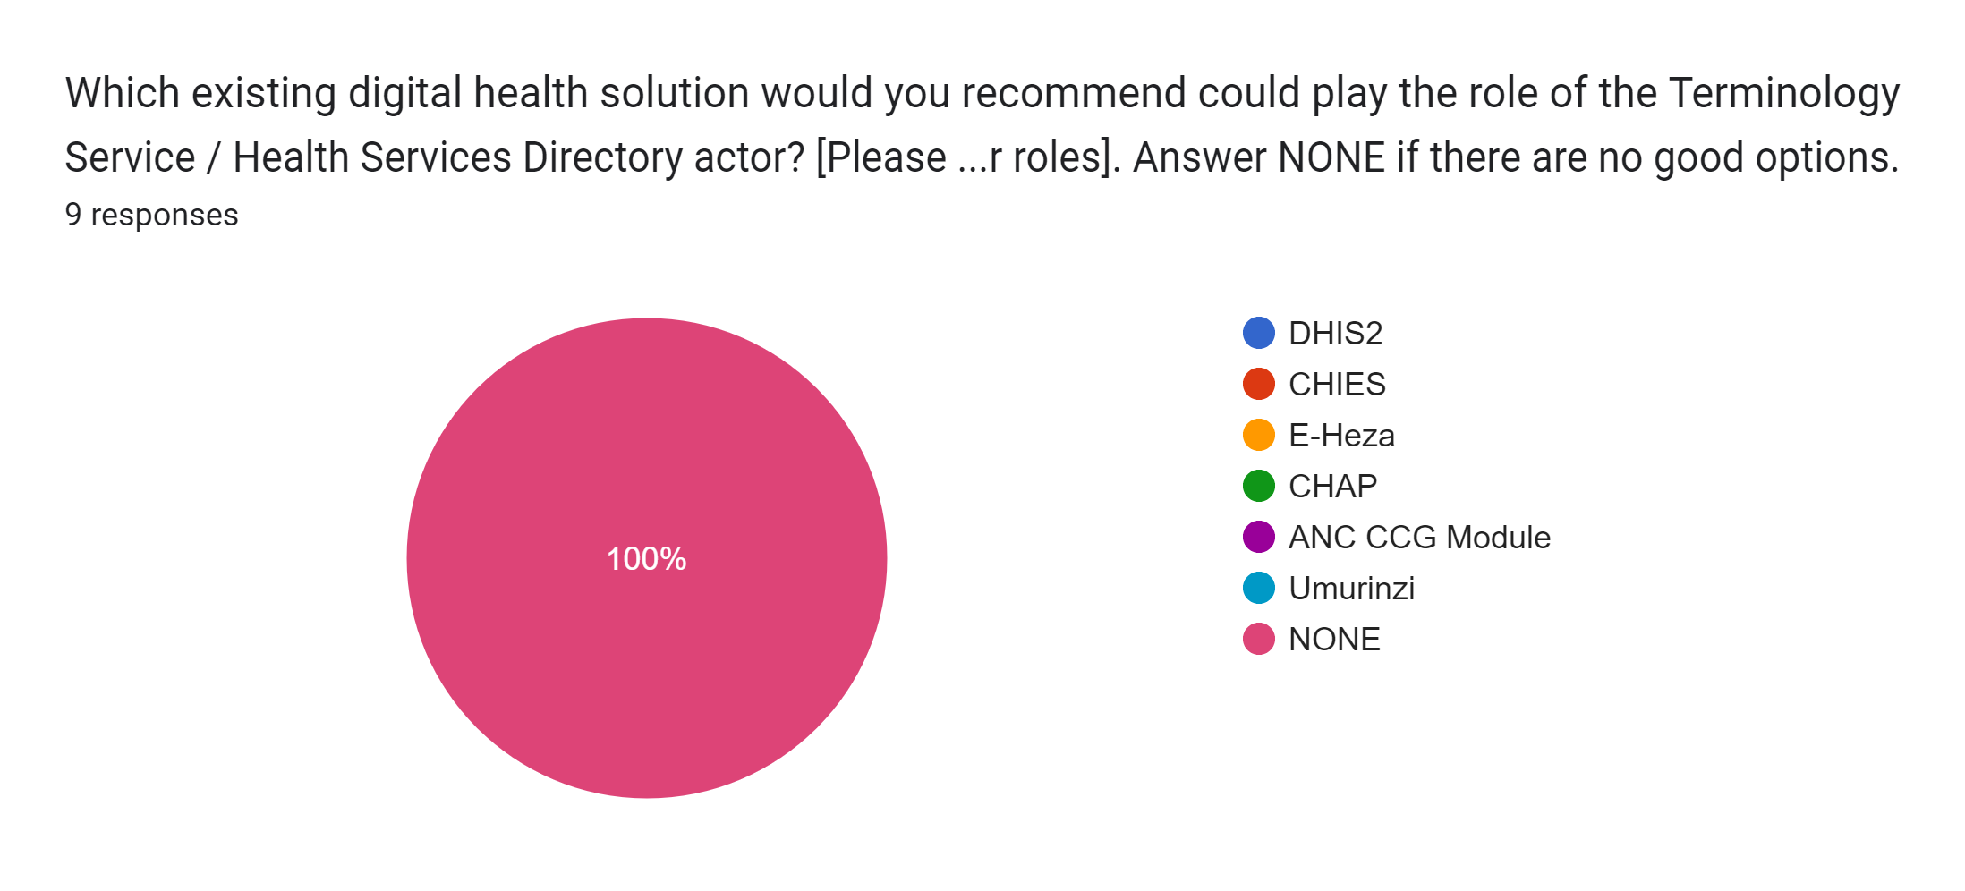



Interaction 3.2

Slide 29
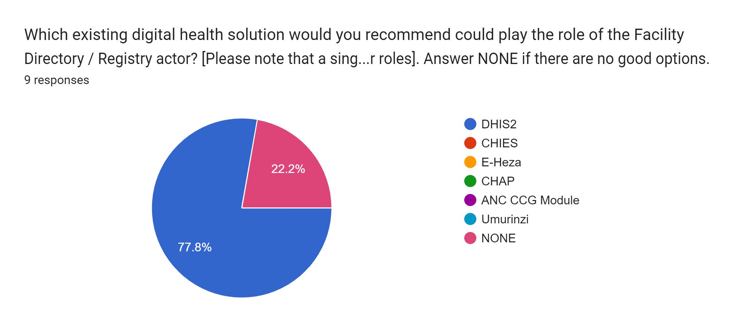
Interaction 3.2

Slide 30
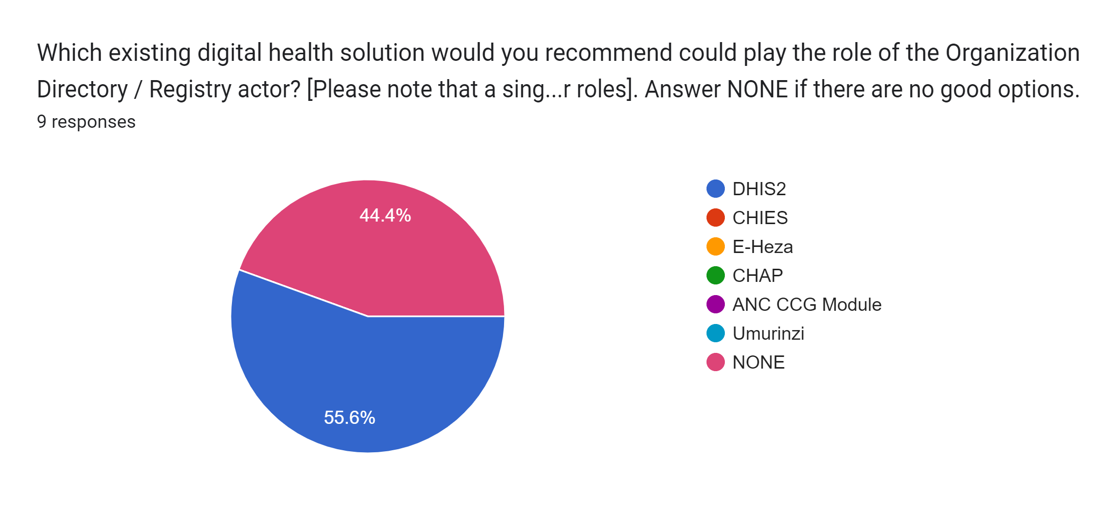
Interaction 3.2

Slide 31
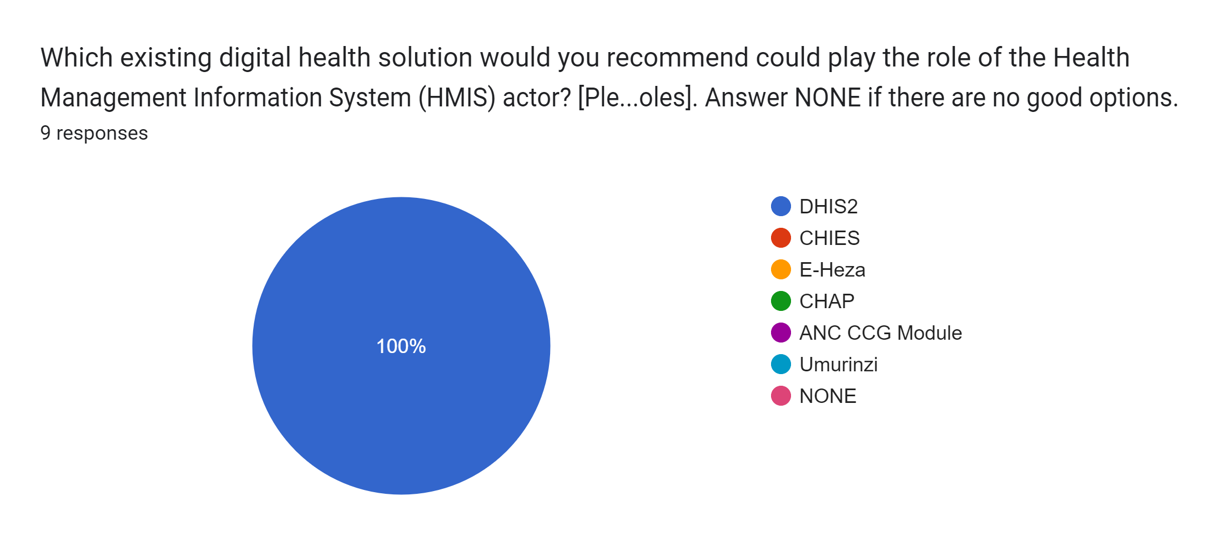
Interaction 3.2

Slide 32
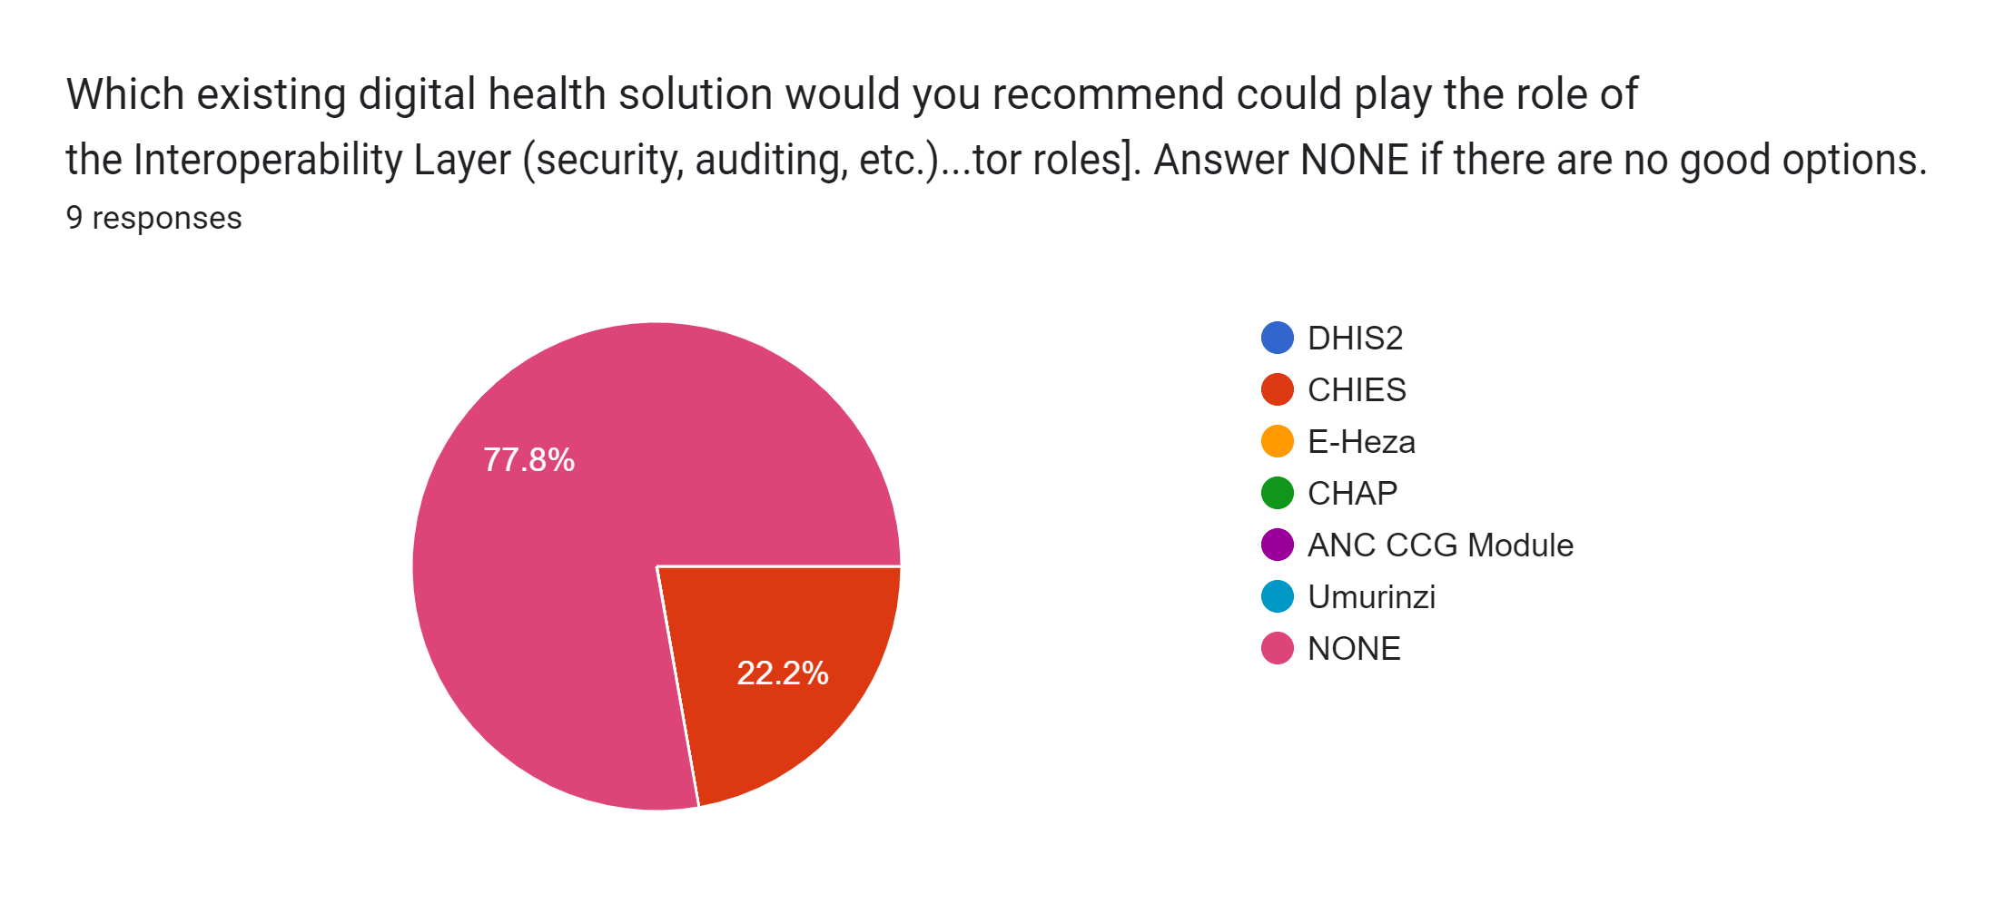
Interaction 3.2

Slide 33
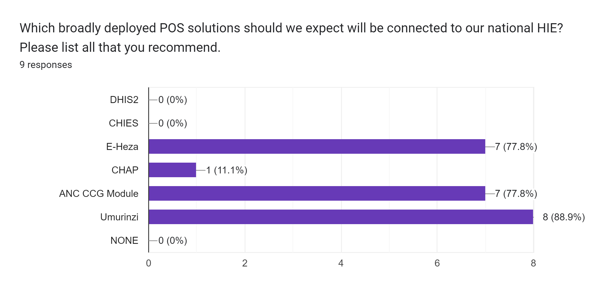
Interaction 3.2

Slide 34
For those legacy solutions we want to leverage… how do we ensure they are “ready to connect”?

Slide 35
Design principles
Reminder
The recommended HIE deployment model is cloud-hosted.
An online transaction processing (OLTP) FHIR Server will be optimized for performance.
In order to defend its performance, batch, maintenance, or analytics-focused processing will operate separately from the OLTP FHIR Server.
An enterprise service bus will orchestrate transactions and will centralize security, privacy, and auditing.
POS solutions that operate in an occasionally offline mode will be expected to leverage local caching and have a synchronization capability once re-connected.

Slide 36
Leveraging legacy solutions
Reminder
There may be architectural elements have been deployed and taken to scale.
Where practical, these legacy solutions will be incorporated into the HIE. This will be accomplished by developing a standards-conformant wrapper (a façade) for the existing solution.
The façade will be used to add a communications interface to the legacy solution that adheres to the HIE’s normative transaction processing specifications.
Loose coupling will be favoured; this will best defend OLTP performance of the HIE’s FHIR Server.

Slide 37


Reminder
Legacy
Software
Solution
Standards-based
Interface
Proprietary
Interface
The software façade ingests the legacy software solution’s proprietary interface, applies mapping and translation routines, and exposes the transformed messages via a standards-based interface. A façade can be constructed to operate as a 1-way or as a 2-way communications interface.

Slide 38

Examples: Legacy Solutions
with FHIR-conformant wrappers
ORG
Reminder
Interoperability Layer
(16)
(16)
(16)
(16)
OLTP FHIR Server
(2)
(9)
TS*
(5)
ILR/TS
ILR-HWR
ILR-FR
ILR-ORG
SHR
HMIS
CR*
CR
(7)
(10)
(11,12,13,14)
(10)
(10)
(10)
(8)
(9)
(8*)
(15)
(7)
ATNA
(8)
(9)
(10)
(11,12,13,14)
(15)
(1)
(Maintenance/batch transactions)
(Real-time runtime transactions)
CR*
POS
(6)
POS
Solution
(9)
CCG
Engine
(17)
(18)

Slide 39
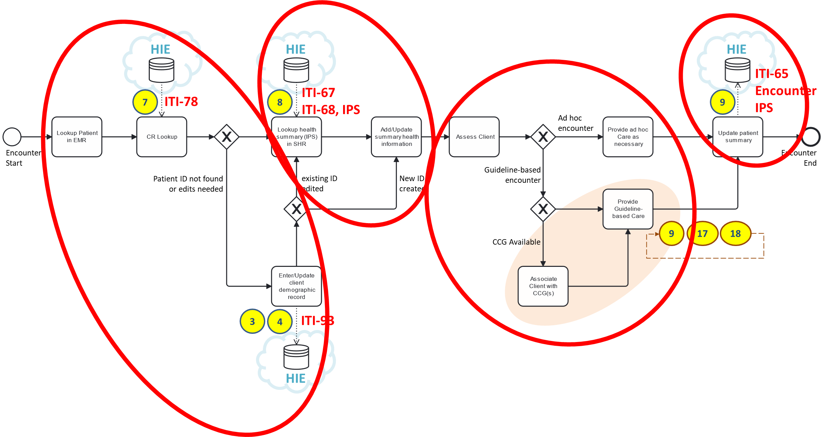
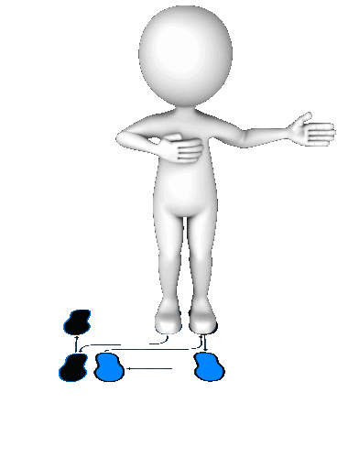
The mandatory POS behaviours can be thought of as a simple 1-2-3-4 pattern (like in a dance).
Reminder
Retrieve the subject’s health summary.
Update the subject’s health summary
Unambiguously identify the subject of care.
Based on the summary, and on the current situation, provide appropriate care.

Slide 40
Important notes…
Our choices regarding the HIE architecture (Workshop-2) should be officially adopted by the MOH. These become our national norms and standards for digital health.
All digital health solution need to demonstrably conform to these national norms before they can be allowed to connect to our HIE.

Slide 42
Interaction 3.3
<insert Form link, here>
Who should conduct the digital health conformance-testing?
How will necessary software updates be paid for?
How long should point of service (POS) solutions be given to become conformant?
What supports should be made available to help solutions achieve conformity?

Slide 43
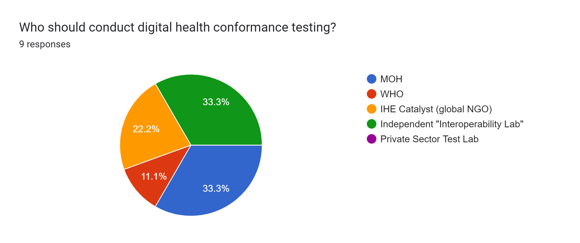
Interaction 3.3

Slide 44
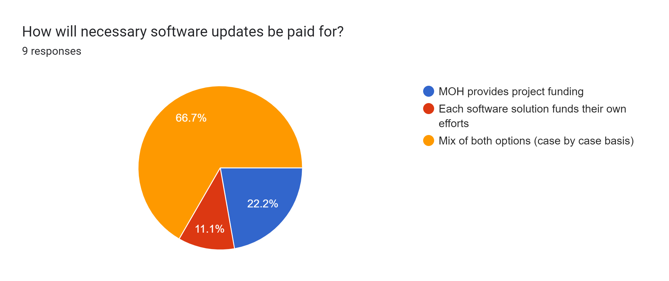
Interaction 3.3

Slide 45
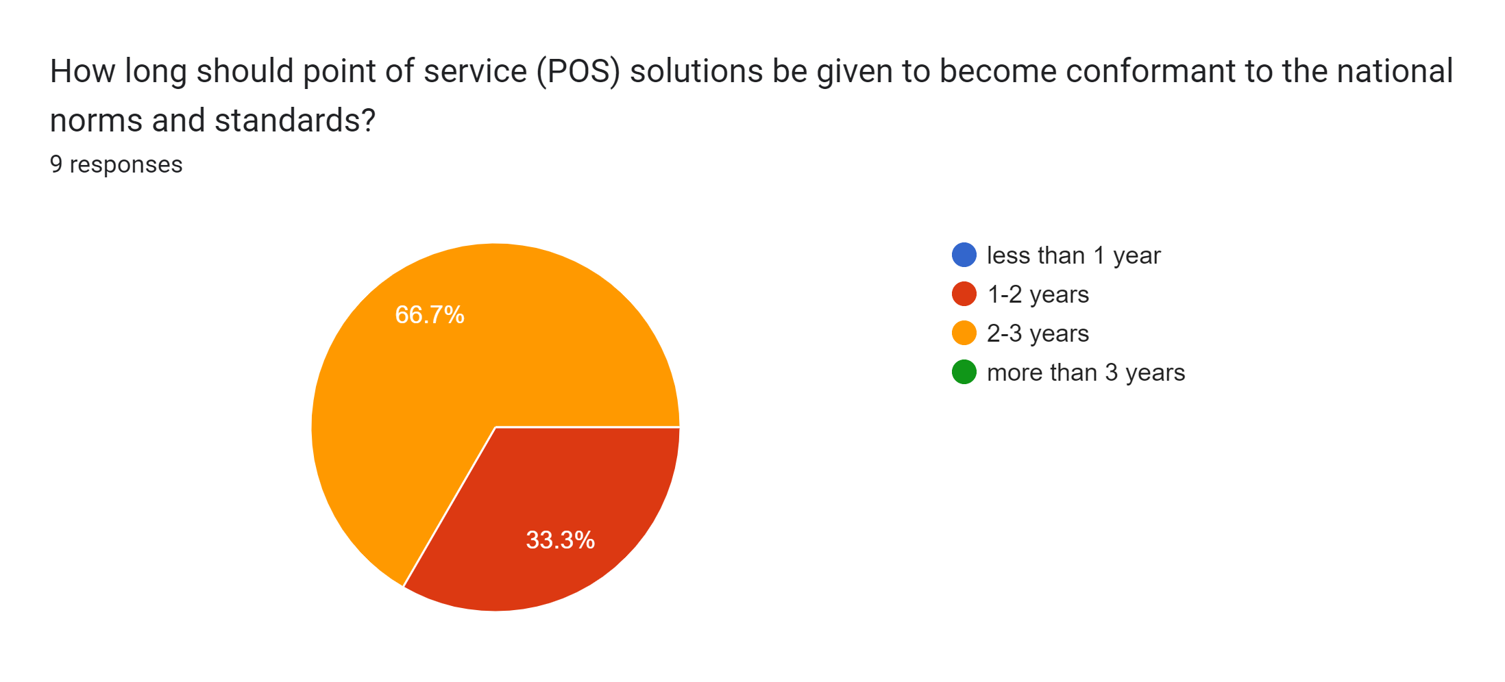
Interaction 3.3

Slide 46
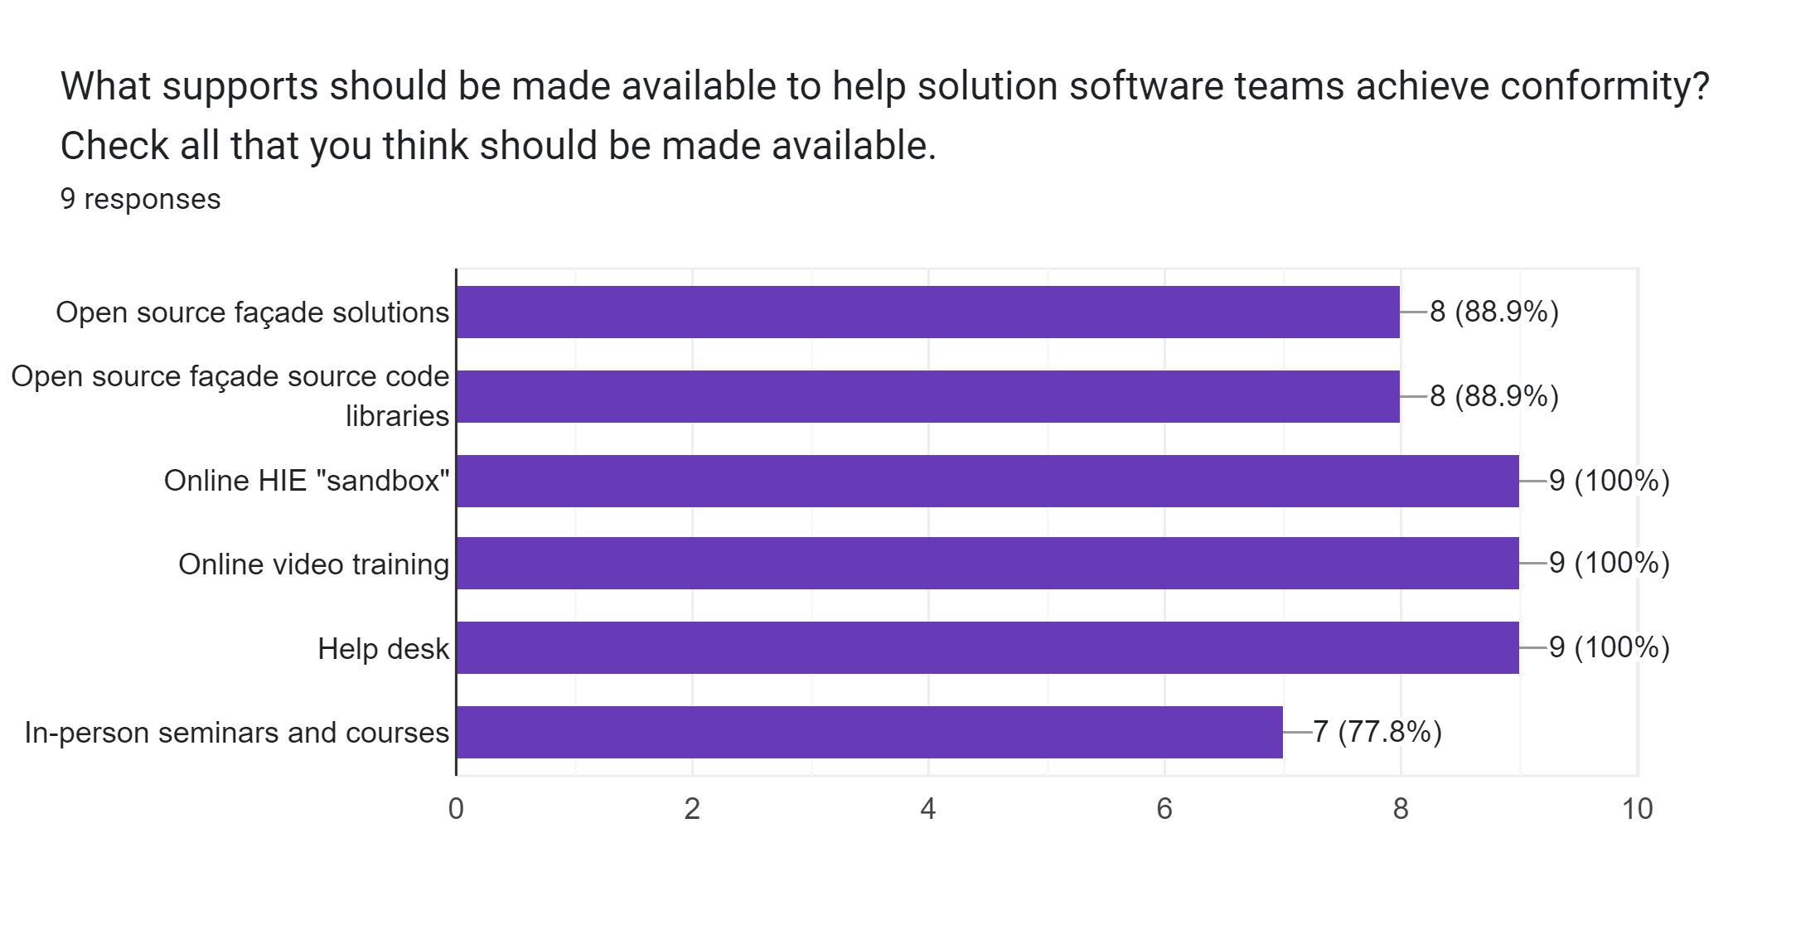
Interaction 3.3

Slide 47
Next steps: Workshop-4
Explore the governance and legal aspects related to deploying a national HIE.
Evaluate different implementation options and their trade-offs.
Inform the notional project schedule, and best-guess deployment assumptions, that will yield a pro forma investment case for the HIE project.
Remember – you will need your PC, tablet, or smartphone to fill in the questionnaires.

